Slide 1
CLUSTERING THE NEIGHBORHOODS OF DATA SCIENCE COMPANIES IN US
Submitted By,
Prabhu Mayilsamy
(Data Scientist)

Slide 2
Introduction/Business requirement
The main problem faced by all the jobseekers is relocation. Since we don’t have proper dataset of the facilities in the new location, we will always feel uncomfortable and sometimes jobseekers will be frustrated by searching for too many venues around the new place
We should love the environment where we are going to work, so that we will do the work with pleasure.
Our main objective of this project is to find out the locations of all the IT companies in the US and cluster them based on the domain of the company
Then based on the input provided by the jobseeker, we can filter the neighborhood top venues of the selected domain companies in US

Slide 3
Data Section
First, I tried to do it for Companies for India. Since here in India datasets are not publicly available, I came up with an idea of doing it for US
Then I extracted the csv file format of US Open 500 Companies dataset. Along with dataset, we can explore the nearby venues of these Companies using Four Square API
The Open 500 Companies dataset contains the fields or columns such as Company Name, City, State, Company Category, Company Type.
The Venues Dataset – obtained through Four Square API contains counts of Venues closed to the Neighborhood and the frequency of each Venues Category such as Office, Bus Stop, Pizza Place, Coffee, Chinese Restaurant, Italian Restaurant, etc.
Link to the Dataset : Open Company Dataset Link

Slide 4
methodology
The company dataset has been downloaded from this link: Link to dataset. For the simplicity I have downloaded the dataset that is in csv format and stored it in my project location
After analyzing the dataset , I came to know that company_id, url, country, full time employees, revenue source, description, data types, data impacts, financial info, last updated fields are no more needed as they don’t make any sense when building a model. So I dropped those columns and extracted the remaining columns.
In this section, I will further explain about how I figured out the relationship between the variables used in the modelling

Slide 5
Methodology(CONTD)
Replacing the Mismatch Values
After analyzing the values in the company category columns using value_counts() function in pandas package, I have figured out that there are few rows that has the same value but in different way those were represented.
For example,
Data/Technology as Data/Technology,
Housing/Real Estate as Housing/Real Estate,
I have changed the values in these rows and made it same by renaming the values in the data frame in python pandas

Slide 6
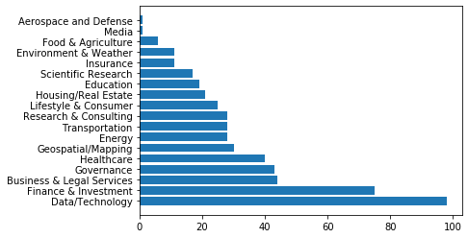
Methodology(CONTD)
Visualizing Each Type of Companies Count in US
Using matplotlib and python pandas function, I have count the number of different category companies and their count using value_counts() function and converted that into data frame and visualized it

Slide 7
Methodology(CONTD)
Data Wrangling
From the analysis, we come to know that company category plays a vital role in clustering the different domains and city and state columns are also very important
We have to handle the missing values in these columns. Since only 3 values are missing in company category field, we can remove these 3 rows as they wont affect the result much
In city and state columns also , only few rows are containing NaN values. So we can drop those rows also.
Company category column contains around 18 unique entries. Machine learning algorithms are good to handle numerical data in best way
We can convert those columns into numerical mapped values and store it in another column named category Label.

Slide 8
Methodology(CONTD)
K- Means Clustering
K-means clustering is a type of unsupervised learning, which is used when you have unlabeled data (i.e., data without defined categories or groups)
The goal of this algorithm is to find groups in the data, with the number of groups represented by the variable K. The algorithm works iteratively to assign each data point to one of K groups based on the features that are provided
Data points are clustered based on feature similarity. The results of the K-means clustering algorithm are:
1) The centroids of the K clusters, which can be used to label new data
2) Labels for the training data (each data point is assigned to a single cluster)
Rather than defining groups before looking at the data, clustering allows you to find and analyze the groups that have formed organically. The "Choosing K" section below describes how the number of groups can be determined
Each centroid of a cluster is a collection of feature values which define the resulting groups. Examining the centroid feature weights can be used to qualitatively interpret what kind of group each cluster represents

Slide 9
Methodology(CONTD)
Four Square API
Foursquare is a social location service that allows users to explore the world around them. Users can download the Foursquare application to their iPhone, Blackberry, or Android phone and sign up for free, then connect their Foursquare accounts to their other social media accounts
After users download the free application and connect on Facebook or Twitter, they can connect with their friends who are also active on Foursquare. Whenever they or their friends check in to a place, the message is broadcast to their friends via Twitter or Facebook.
When a user checks in enough times, that user becomes the mayor of a location, which may or may not give the user access to special offers, depending on the business running a location
The Foursquare API allows application developers to interact with the Foursquare platform. The API itself is a RESTful set of addresses to which you can send requests, so there's really nothing to download onto your server

Slide 10
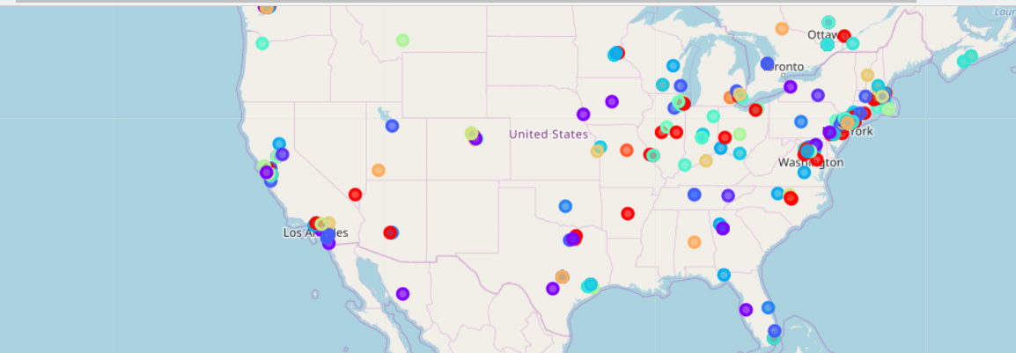
RESults
I have formed clusters of different domain companies in the data frame and then visualized the different clusters using the folium map
Folium is a great visualization library that is used to visualize the map and help us to zoom in and zoom out in the created map

Slide 11
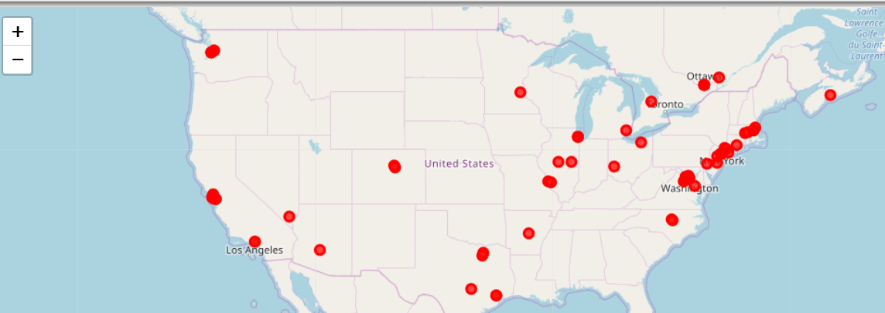
RESults(CONTD)
After Visualizing all the domain companies in the map, we can visualize only the given domain companies in the map using the prompt like thing
For simplicity, I am going to visualize the data /technology domain companies alone in the map and then we can explore the neighborhood top venues

Slide 12
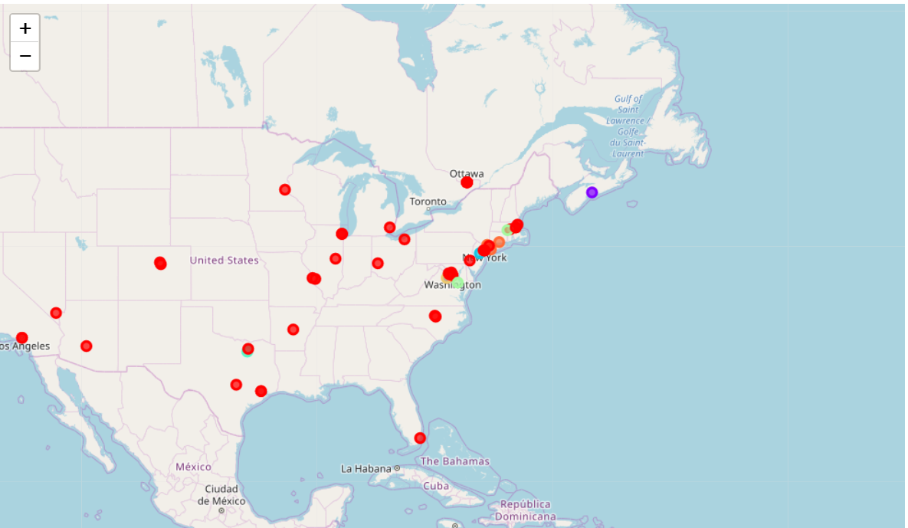
RESults(CONTD)
Using K-Means Clustering Algorithm, I have clustered the top venues of the data science companies in US into 8 different clusters. We can cluster into how much clusters we want to do
These 8 clusters can be put into Folium Map and visualized using 8 different colors

Slide 13
RESults(CONTD)
From the project ,we came to know that in US, there are many data science( i.e Data/Technology) companies are founded. So we can say that data science is the best domain to work with.
We have found out where and all different domain companies are located in US. From the map plotted earlier, we can say that most of the data science companies are located in Washington, New York and Toronto. So these places are best to relocate to US
From the project and map, we can say that the most common places near Data/Technology companies in US are restaurants, coffee shops and Bakery shops.

Slide 14
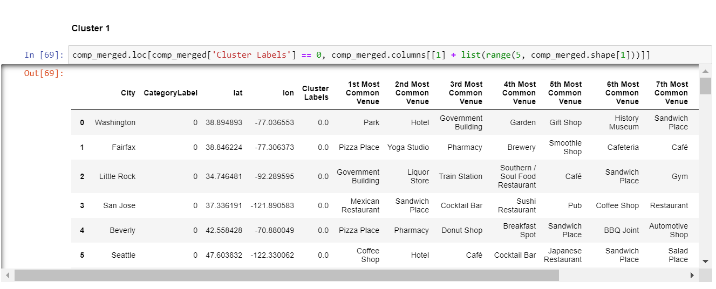
RESults(CONTD)
We can view each and every clusters. For example, the first cluster containing mostly the restaurant venues

Slide 15
discussion
Our problem statement is like when job seekers want to search for jobs in particular location, they will find it difficult to google it
If we provide them with list of different domain companies in a map and let them explore the top venues in the nearby places makes them easy to come to know about the feasibility level of migration so that they can easily decide and don’t need to spend too much time in web surfing for the details
This project was implemented only for US companies. When we collect all the country company details, we can process the huge data (Big Data) using Hadoop and make it work for all the countries
That’s what my recommendation for this project. That may be future work of this project

Slide 16
conclusion
First I identified the problem statement I took . The business requirement is like, when we want to migrate to some other company and in some other location, then we will find it difficult to migrate since we don’t know about the location
In this project, I have addressed about how to visualize the different domain companies in US country. Then I clustered the companies based on their domain and then I visualized the data using Folium map so that it will be easy to understand them
The another important thing what job seekers will expect is like, when they migrate, will they avail all the facilities in the new location. To address this problem, I have clustered the top venues around the Data/Technology domain companies and visualized it using Folium Map
We can collect all the country company details and make this project work for all the countries and all domain companies. From the project, I came to know that Data Science is the most growing field in the World especially in US

Slide 17
Thank you

